Slide 1
Numerical Algorithms
Matrix multiplication
Numerical solution of Linear System of Equations

Slide 2
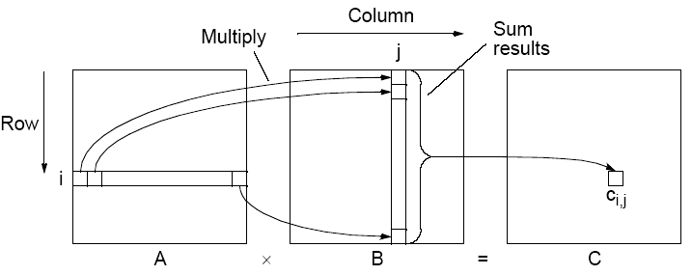
Matrix multiplication, C = A x B

Slide 3
Sequential Code
Assume throughout that the matrices are square (n x n matrices).
The sequential code to compute A x B :
for (i = 0; i < n; i++)
for (j = 0; j < n; j++) {
c[i][j] = 0;
for (k = 0; k < n; k++)
c[i][j] = c[i][j] + a[i][k] * b[k][j];
}
Requires n³ multiplications and n³ additions
T_{seq} = (n³) (Very easy to parallelize!)

Slide 4
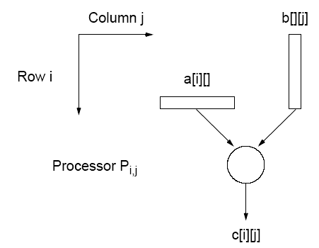
Direct Implementation (P=n²)
One PE to compute each element of C - n² processors would be needed.
Each PE holds one row of elements of A and one column of elements of B.
P = n²
➔ T_{par} = O(n)

Slide 5
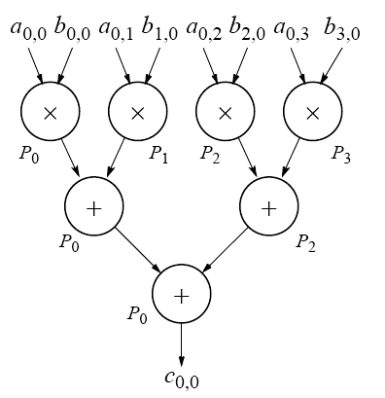
Performance Improvement (P=n³)
n processors collaborate in computing each element of C - n³ processors are needed.
Each PE holds one element of A and one element of B.
P = n³
➔ T_{par} = O(log n)

Slide 6
Parallel Matrix Multiplication - Summary
P = n T_{par} = O(n²)
Each instance of inner loop is independent and can be done by a separate processor.
Cost optimal since O(n³) = n * O(n²)
P = n² T_{par} = O(n)
One element of C (c_{ij}) is assigned to each processor.
Cost optimal since O(n³) = n² x O(n)
P = n³ T_{par} = O(log n)
n processors compute one element of C (c_{ij}) in parallel (O(log n))
Not cost optimal since O(n³) < n³ * O(log n)
O(log n) lower bound for parallel matrix multiplication.

Slide 7
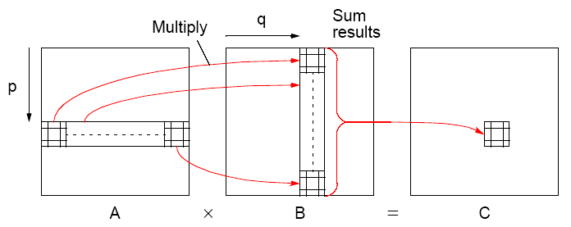
Block Matrix Multiplication

Slide 8
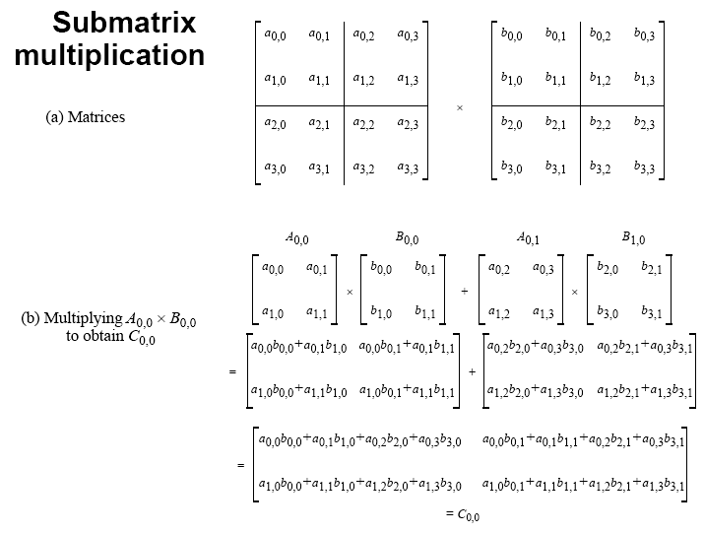

Slide 9
Mesh Implementations
Cannon’s algorithm
Systolic array
All involve using processors arranged into a mesh (or torus) and shifting elements of the arrays through the mesh.
Partial sums are accumulated at each processor.

Slide 10
Elements Need to Be Aligned
Each triangle
represents a
matrix element (or a block)
Only same-color
triangles should
be multiplied
B00
B01
B02
B03
A00
A01
A02
A03
B10
B11
B12
B13
A10
A11
A12
A13
B20
B21
B22
B23
A20
A21
A22
A23
B30
B31
B32
B33
A30
A31
A32
A33

Slide 11
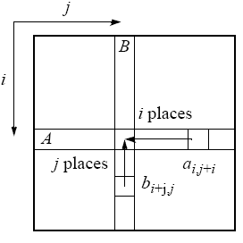
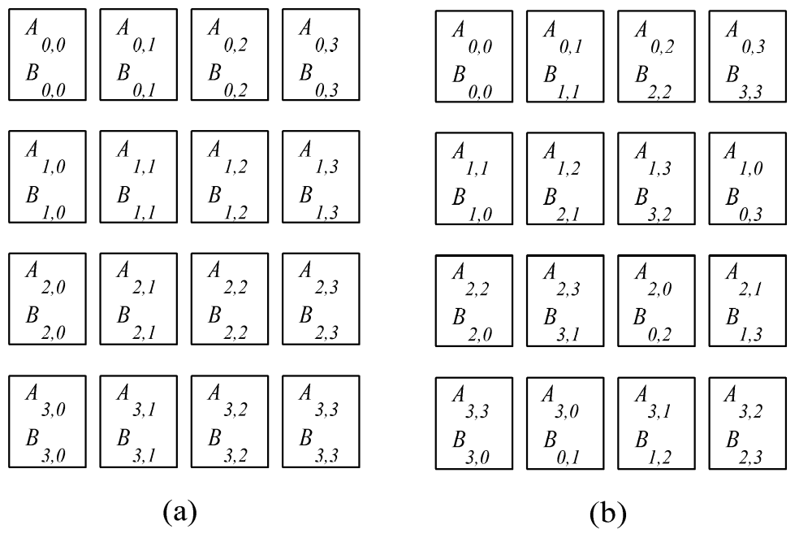
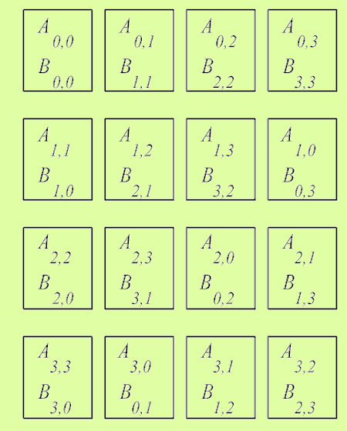
Alignment of elements of A and B
Before
After

Slide 12
Alignment
B00
B11
B22
B33
A00
A01
A02
A03
A_{i*} (i^{th} row) cycles
left i positions
B_{*j} (j^{th} column) cycles up j positions
B10
B21
B32
B03
A11
A12
A13
A10
B20
B31
B02
B13
A22
A23
A20
A21
B30
B01
B12
B23
A33
A30
A31
A32

Slide 13
Shift, multiply, add
Consider Process P_{1,2}
B22
A11
A12
B32
Step 1
A13
A10
B02
B12

Slide 14
Shift, multiply, add
Consider Process P_{1,2}
B32
A12
A13
B02
Step 2
A10
A11
B12
B22

Slide 15
Shift, multiply, add
Consider Process P_{1,2}
B02
A13
A10
B12
Step 3
A11
A12
B22
B32

Slide 16
Shift, multiply, add
Consider Process P_{1,2}
B12
A10
A11
B22
Step 4
A12
A13
B32
B02

Slide 17
Parallel Cannon’s Algorithm
Uses a torus to shift the A elements (or submatrices) left and the B elements (or submatrices) up in a wraparound fashion.
Initially processor P_{i,j} has elements a_{i,j} and b_{i,j} (0 ≤ i < n, 0 ≤ j < n).
Elements are moved from their initial position to an “aligned” position. The complete i^{th} row of A is shifted i places left and the complete j^{th} column of B is shifted j places upward. This has the effect of placing the element a_{i,j+i} and the element b_{i+j,j} in processor P_{i,j}. These elements are a pair of those required in the accumulation of c_{i,j}.
Each processor, P_{i,j}, multiplies its elements and accumulates the result in c_{i,j}
The i^{th} row of A is shifted one place right, and the j^{th} column of B is shifted one place upward. This has the effect of bringing together the adjacent elements of A and B, which will also be required in the accumulation.
Each PE (P_{i,j}) multiplies the elements brought to it and adds the result to the accumulating sum.
The last two steps are repeated until the final result is obtained (n-1 shifts)

Slide 18
Time Complexity
P = n² A, B: n x n matrices with n² elements each
One element of C (c_{ij}) is assigned to each processor.
Alignment step takes O(n) steps.
Therefore,
T_{par} = O(n)
Cost optimal since O(n³) = n² * O(n)
Also, highly scalable!

Slide 19
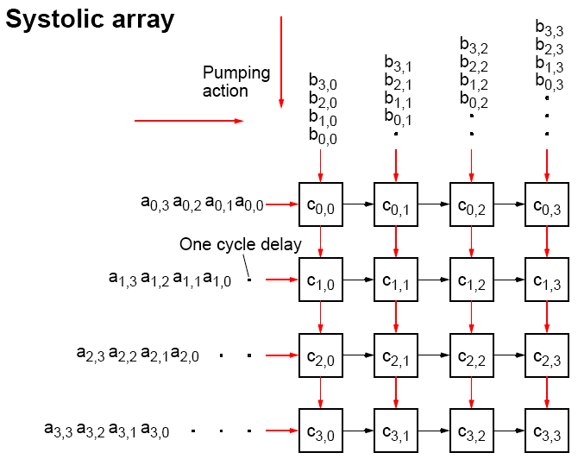
Systolic Array

Slide 20
Solving systems of linear equations: Ax=b
Dense matrices
Direct Methods:
Gaussian Elimination – seq. time complexity O(n³)
LU-Decomposition – seq. time complexity O(n³)
Sparse matrices (with good convergence properties)
Iterative Methods:
Jacobi iteration
Gauss-Seidel relaxation (not good for parallelization)
Red-Black ordering
Multigrid

Slide 21
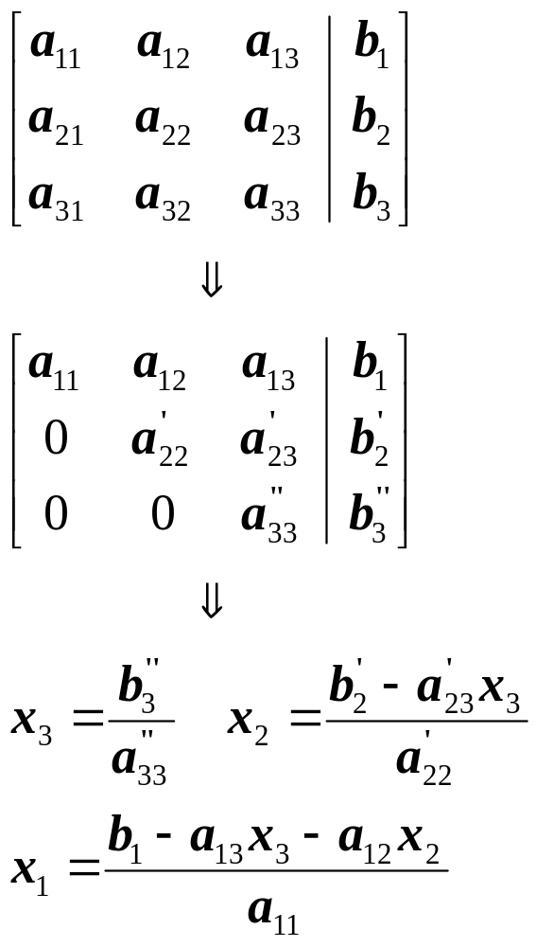
Gauss Elimination
Solve Ax = b
Consists of two phases:
  Forward elimination
  Back substitution
Forward Elimination
reduces Ax = b to an upper triangular system Tx = b’
Back substitution can then solve Tx = b’ for x
Forward
Elimination
Back
Substitution

Slide 22
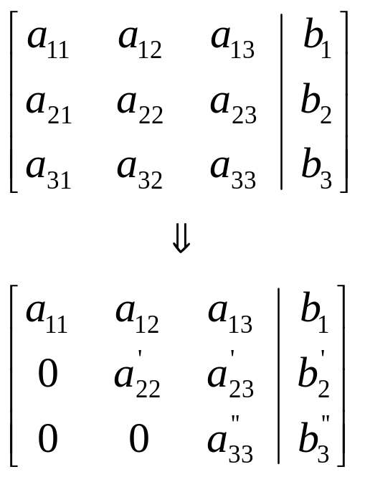
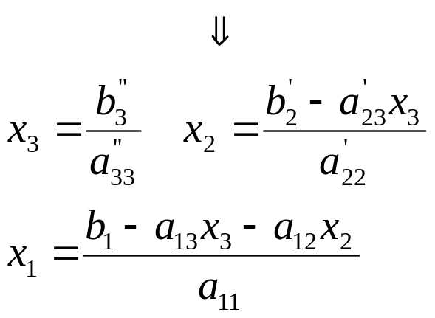
Gauss Elimination
Solve Ax = b
Consists of two phases:
  Forward elimination
  Back substitution
Forward Elimination
reduces Ax = b to an upper triangular system Tx = b’
Back substitution can then solve Tx = b’ for x
Forward
Elimination
Back
Substitution

Slide 23
Gaussian Elimination
Forward Elimination
x₁ - x₂ + x₃ = 6
3x₁ + 4x₂ + 2x₃ = 9
2x₁ + x₂ + x₃ = 7
x₁ - x₂ + x₃ = 6
0 +7x₂ - x₃ = -9
0 + 3x₂ - x₃ = -5
-(3/1)
-(2/1)
-(3/7)
x₁ - x₂ + x₃ = 6
0 7x₂ - x₃ = -9
0 0 -(4/7)x₃=-(8/7)
Solve using BACK SUBSTITUTION: x₃ = 2 x₂=-1 x₁ =3
0
0
0
0
0
0
0
0
0
0
0
0
0
0
0
0
0
0
0
0
0
0
0
0
0
0
0
0
0
0
0
0
0
0
0
0

Slide 24
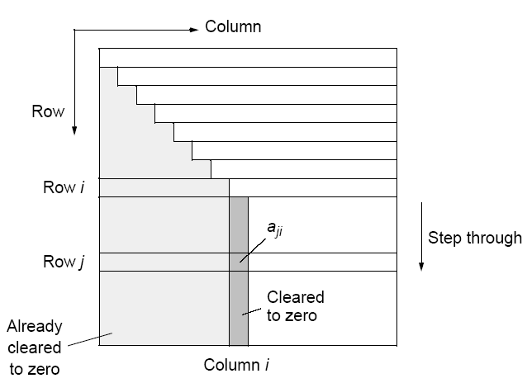
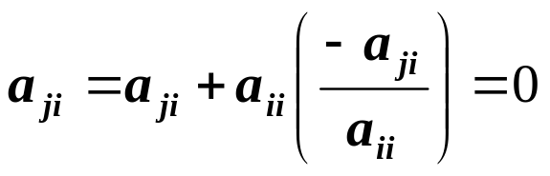
Forward Elimination

Slide 25
Gaussian Elimination
M
U
L
T
I
P
L
I
E
R
S
4x₀
+6x₁
+2x₂
– 2x₃
=
8
2x₀
+5x₂
– 2x₃
=
4
-(2/4)
-(-4/4)
–4x₀
– 3x₁
– 5x₂
+4x₃
=
1
8x₀
+18x₁
– 2x₂
+3x₃
=
40
-(8/4)

Slide 26
Gaussian Elimination
M
U
L
T
I
P
L
I
E
R
S
4x₀
+6x₁
+2x₂
– 2x₃
=
8
– 3x₁
+4x₂
– 1x₃
=
0
+3x₁
– 3x₂
+2x₃
=
9
-(3/-3)
+6x₁
– 6x₂
+7x₃
=
24
-(6/-3)

Slide 27
Gaussian Elimination
4x₀
+6x₁
+2x₂
– 2x₃
=
8
M
U
L
T
I
P
L
I
E
R
– 3x₁
+4x₂
– 1x₃
=
0
1x₂
+1x₃
=
9
2x₂
+5x₃
=
24
??

Slide 28
Gaussian Elimination
4x₀
+6x₁
+2x₂
– 2x₃
=
8
– 3x₁
+4x₂
– 1x₃
=
0
1x₂
+1x₃
=
9
3x₃
=
6

Slide 29
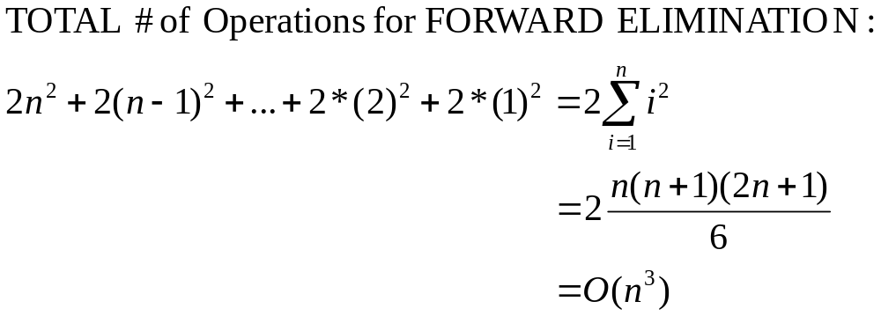
Gaussian Elimination
Operation count in Forward Elimination
b₁₁
2n
0
b₂₂
2n
0
0
b₃₃
2n
2n
2n
2n
2n
2n
0
0
0
b₄₄
0
0
0
0
b₅₅
0
0
0
0
0
b₆₆
0
0
0
0
0
0
b₇₇
0
0
0
0
0
0
0
b₆₆
0
0
0
0
0
0
0
0
b₆₆
TOTAL
1st column: 2n(n-1) ≅ 2n²
2(n-1)²
2(n-2)²
…….

Slide 30
Back Substitution
(* Pseudocode *)
for i ← n − 1 down to 1 do
/* calculate x_{i} */
x [ i ] ← b [ i ] / a [ i, i ]
/* substitute in the equations above */
for j ← 0 to i − 1 do
b [ j ] ← b [ j ] − x [ i ] × a [ j, i ]
endfor
endfor
Time Complexity? ➔➔ O(n²)

Slide 31
Partial Pivoting
If a_{i,i} is zero or close to zero, we will not be able to compute the quantity -a_{j,i} / a_{i,i}
Procedure must be modified into so-called partial pivoting by swapping the i^{th} row with the row below it that has the largest absolute element in the i^{th} column of any of the rows below the i^{th} row (if there is one).
(Reordering equations will not affect the system.)

Slide 32
Sequential Code
Without partial pivoting:
for (i = 0; i < n-1; i++) /* for each row, except last */
for (j = i+1; j < n; j++) { /* step thro subsequent rows */
m = a[j][i]/a[i][i]; /* Compute multiplier */
for (k = i; k < n; k++) /* last n-i-1 elements of row j */
a[j][k] = a[j][k] - a[i][k] * m;
b[j] = b[j] - b[i] * m; /* modify right side */
}
The time complexity: T_{seq} = O(n³)

Slide 33
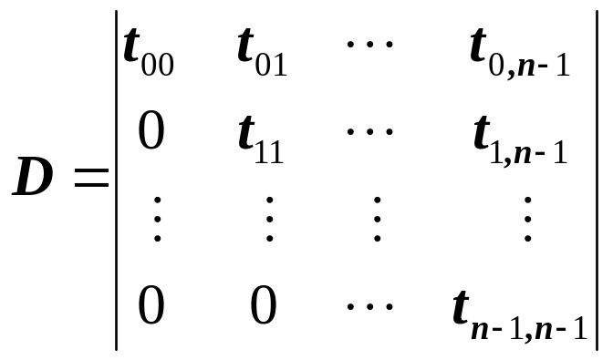
Computing the Determinant
Given an upper triangular system of equations
D = t₀₀ t₁₁… t_{n-1,n-1}
If pivoting is used then
D = t₀₀ t₁₁… t_{n-1,n-1}(-1)^{p} where p is the number of times the rows are pivoted
Singular systems
When two equations are identical, we would loose one degree of freedom
n-1 equations for n unknowns ➔ infinitely many solutions
This is difficult to find out for large sets of equations.
The fact that the determinant of a singular system is zero can be used and tested after the elimination stage.

Slide 34
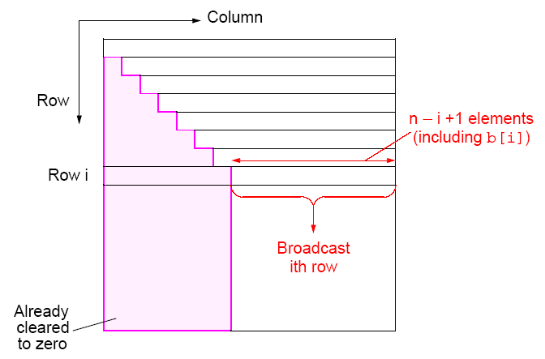
Parallel implementation

Slide 35
Time Complexity Analysis (P = n)
Communication
(n-1) broadcasts performed sequentially - i^{th} broadcast contains (n-i) elements.
Total Time: T_{par} = O(n²) (How ?)
Computation
After row i is broadcast, each processor P_{j} will compute its multiplier, and operate upon n-j+2 elements of its row. Ignoring the computation of the multiplier, there are (n-j+2) multiplications and (n-j+2) subtractions.
Total Time: T_{par} = O(n²)
Therefore, T_{par} = O(n²)
Efficiency will be relatively low because all the processors before the processor holding row i do not participate in the computation again.

Slide 36
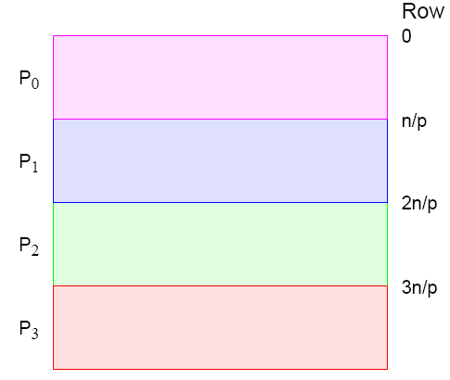
Strip Partitioning
Poor processor allocation!
Processors do not participate in computation after their last row is processed.

Slide 37
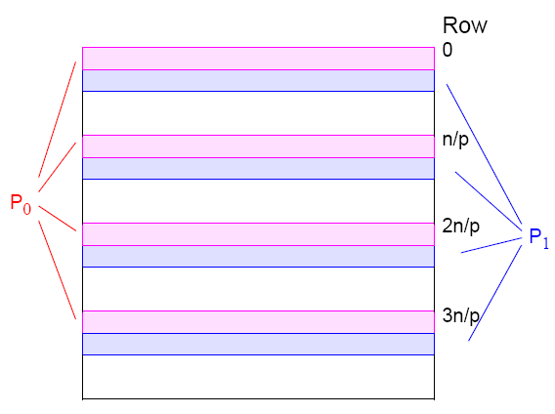
Cyclic-Striped Partitioning
An alternative which equalizes the processor workload

Slide 38
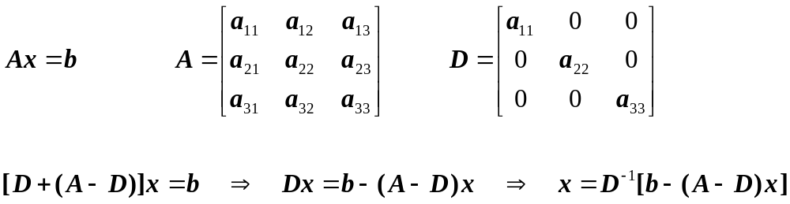
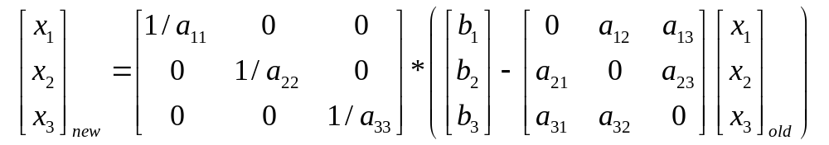
Jacobi Iterative Method (Sequential)
Iterative methods provide an alternative to the elimination methods.
Choose an initial guess (i.e. all zeros) and Iterate until the equality is satisfied.
No guarantee for convergence! Each iteration takes O(n²) time!

Slide 39
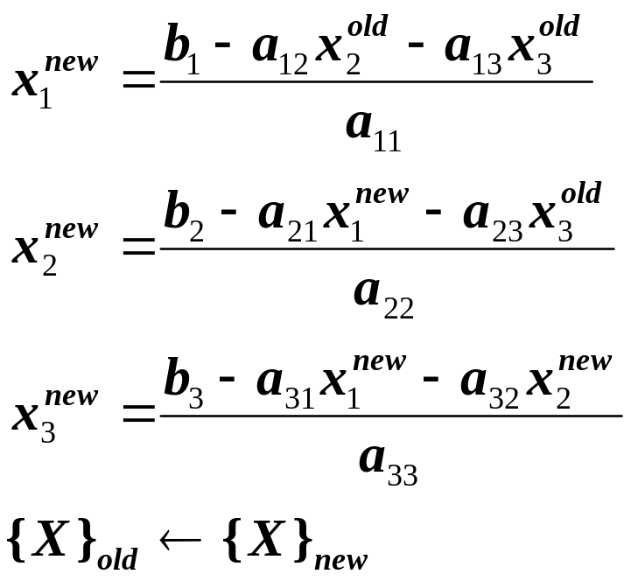
Gauss-Seidel Method (Sequential)
The Gauss-Seidel method is a commonly used iterative method.
It is same as Jacobi technique except with one important difference:
A newly computed x value (say x_{k}) is substituted in the subsequent equations (equations k+1, k+2, …, n) in the same iteration.
Example: Consider the 3x3 system below:
First, choose initial guesses for the x’s.
A simple way to obtain initial guesses is to assume that they are all zero.
Compute new x₁ using the previous iteration values.
New x₁ is substituted in the equations to calculate x₂ and x₃
The process is repeated for x₂, x₃, …

Slide 40
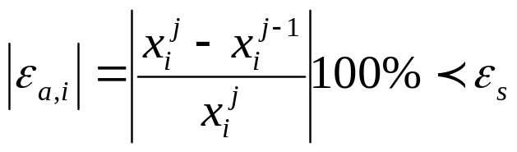
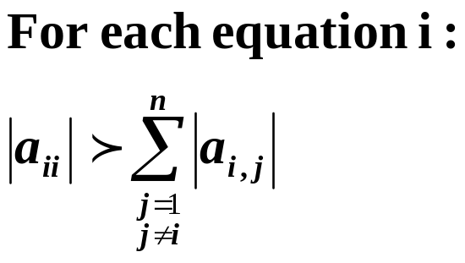
Convergence Criterion for Gauss-Seidel Method
Iterations are repeated until the convergence criterion is satisfied:
For all i, where j and j-1 are
the current and previous iterations.
As any other iterative method, the Gauss-Seidel method has problems:
  It may not converge or it converges very slowly.
If the coefficient matrix A is Diagonally Dominant Gauss-Seidel is guaranteed to converge.
Diagonally Dominant ➔
Note that this is not a necessary condition, i.e. the system may still have a chance to converge even if A is not diagonally dominant.
Time Complexity: Each iteration takes O(n²)

Slide 41
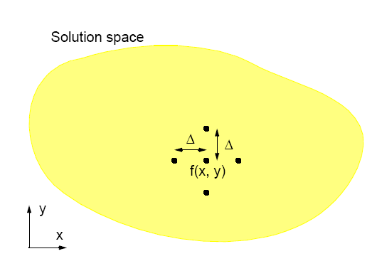
Finite Difference Method

Slide 42
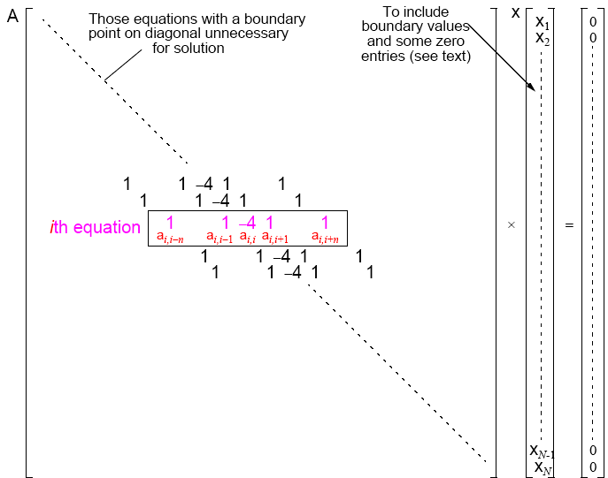

Slide 43
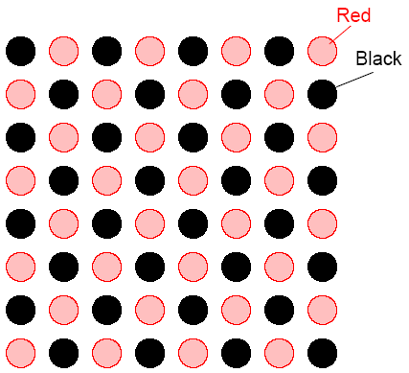
Red-Black Ordering
First, black points computed simultaneously.
Next, red points computed simultaneously.

